Slide 1

Healing the hurt
From disaster to recovery
Notes:
Began study 1971
90% psychiatric and prison experienced trauma as children
Asked to tell brother about murder - felt helpless in the face of despair
Finished, got married, children, migrated to Australia in 1985, worked for public service, did graduate studies
Began age 44 psychiatric hospital
When trauma treatment was just introduced to Australia
Will cover:
Political
Physical
Psychological

Slide 2
Trauma
A wound
that pierces the armour
WWI - Shell Shock
WWII - Battle Fatigue
Korea - Operational Exhaustion
Vietnam - Removed from DSM
1980 - PTSD
Post Traumatic Stress Disorder
Notes:
Janet - l989 - Crimean war and Civil war
1952 - included in first DSM
Removed in 1968 - no trauma assessment or treatment available
Figley - the Wounds of War
What does it look like, feel like. Diagnosis is about symptoms.

Slide 3
Symptoms of PTSD
Hyper-vigilance/hypo-vigilance: irritable, jumpy, anxious, shut down
Intrusive memories: flashbacks, nightmares
Avoidance: people, places, crowds
DSMIII (1980) - based on veterans
DSMIV (1994) - added general population - Disasters
DSM5 (2013) - included children
Notes:
Institutional Abuse another backlash

Slide 4
Notes:
Triune Brain
Sensations create memories scan 40 times a second
Frozen memory networks- not stored but connected with sensations
Initially acute in first 3 months, then consolidates - talking, safety, moving forward, sleeping, breathing, exercising
First cure developed 1989

Slide 5
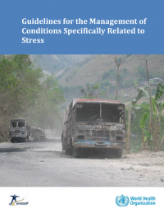

World Health Organisation (2013)
Trauma-focused CBT and EMDR therapy are recommended for children, adolescents and adults with PTSD.
“Like CBT with a trauma focus, EMDR therapy aims to reduce subjective distress and strengthen adaptive cognitions related to the traumatic event. Unlike CBT with a trauma focus, EMDR does not involve:
  detailed descriptions of the event
  direct challenging of beliefs
  extended exposure
  homework.” (p.1)
© Derek Farrell - January 2020/ Rotary World Peace Conference, Ontario, California USA
Notes:
Not selling EMDR - was the first Psychological treatment - eye movements desensitise - name does not help
TF CBT developed - both do memory confrontation
Both require special training - not offered at universities.
Politics of shame - individual, man-made, too hard basket,
Children and ACES
EEI available Red Cross - before memories consolidate

Slide 6
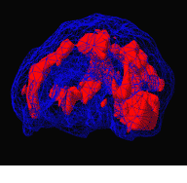
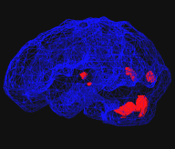
Before and after EMDR brain scans. Left photo shows woman with Post Traumatic Stress Disorder. Right photo shows same patient after four ninety minute EMDR sessions. The red areas indicate over activity in the brain. Photo by Dr. Daniel Amen, reprinted with permission
BEFORE TX
AFTER TX
© Derek Farrell - January 2020/ Rotary World Peace Conference, Ontario, California USA
Notes:
The Brain is designed to heal
Disaster opportunity to raise profile of trauma work -
15 % receive evidence based therapies - private psychologists..
Yet most cases end up in government system.

Slide 7
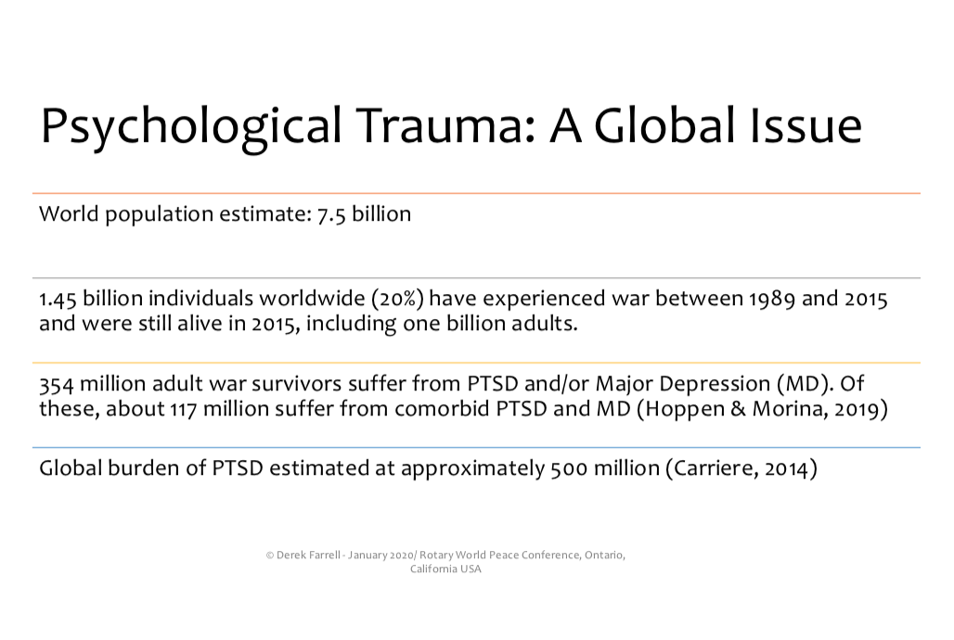

Slide 8
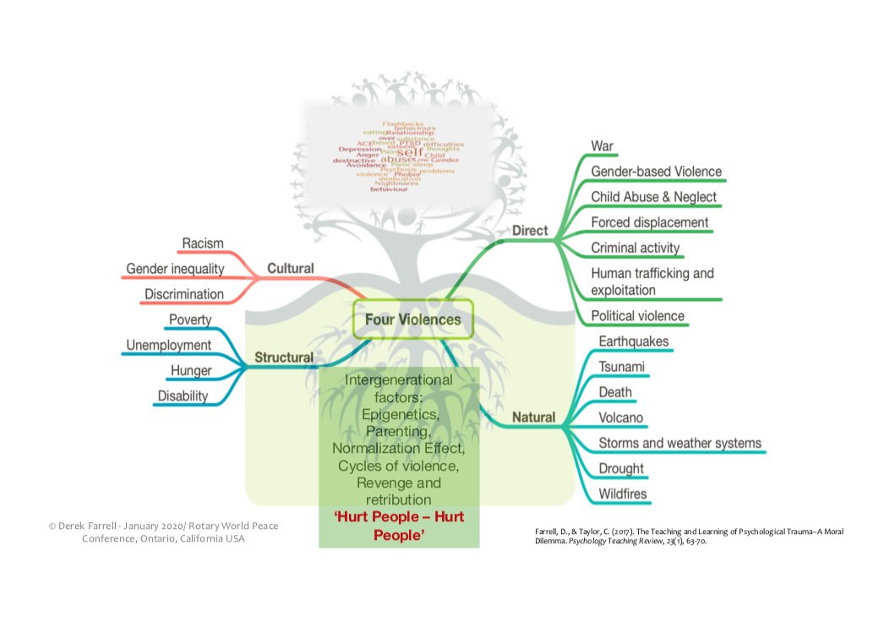

Slide 9
Resources to meet the demand
TIER 3 Specialised Trauma Therapists
TIER 2 GROUP CARE BY PARAPROFESSIONALS in progress
TIER 1 Psychological First Aid and self care

Slide 10
What has rotary done so far?
RC Melbourne: Foundation House- Refugees Tier 3
RC Melbourne : Royal Children’s Hospital Melbourne Tier 3
RAG for Family Safety: Victims of Institutional Abuse : Therapist up-skilling Tier 3
RAG for Family Safety: Best Practice for major Disasters Tier 3

Slide 11
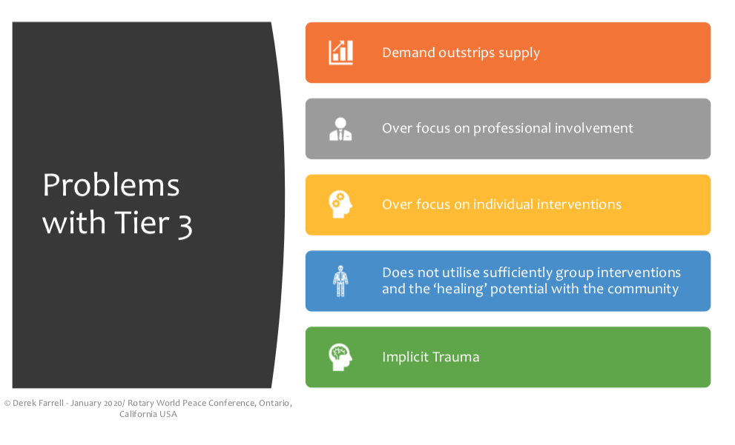

Slide 12
MIND THE GAPs
TOO MANY FOR ONE-ON-ONE THERAPY
COUNTRY AREAS - UNDERSERVED
MULTIPLE IMPACTS - MATERIAL
          - ECONOMIC
          - PSYCHOLOGICAL

Slide 13
COMMUNITY-BASED SOLUTION- GROUP CARE
TREAT GROUPS AS WELL AS INDIVIDUALS
”Equip and empower frontline non-therapist personnel with intermediate yet appropriate skills to make best use of the few mental health professionals available” (GIST-T 2019)

Slide 14
Who are these frontline personnel?
HEALTH CARE WORKERS – Nurses, Doctors, Community Health Workers
SOCIAL CARE WORKERS – Teachers, traditional spiritual leaders, Red Cross
                Volunteers, Scout Leaders
EMERGENCY SERVICES – including military
OTHER NGOs - service club members, including Rotarians

Slide 15
HOW CAN WE DO IT?
STEP ONE - TRAIN TRAINERS from relevant communities
STEP TWO - TRAINERS train frontline personnel (research component)
STEP THREE - FRONTLINES deliver simplified Group Care
          (supervised and supported, self-care, research)

Slide 16
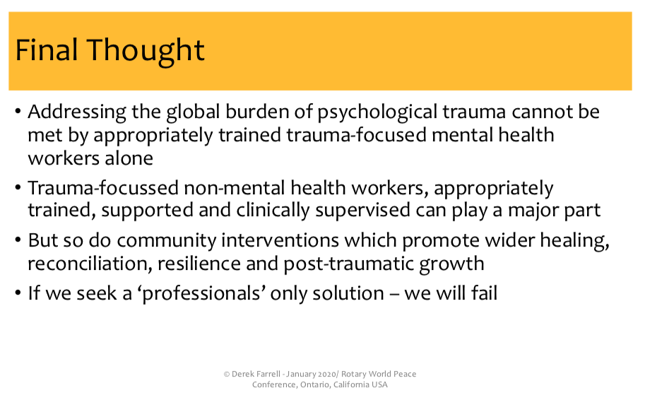

Slide 17
QUESTIONS, PLEASE!

Slide 18
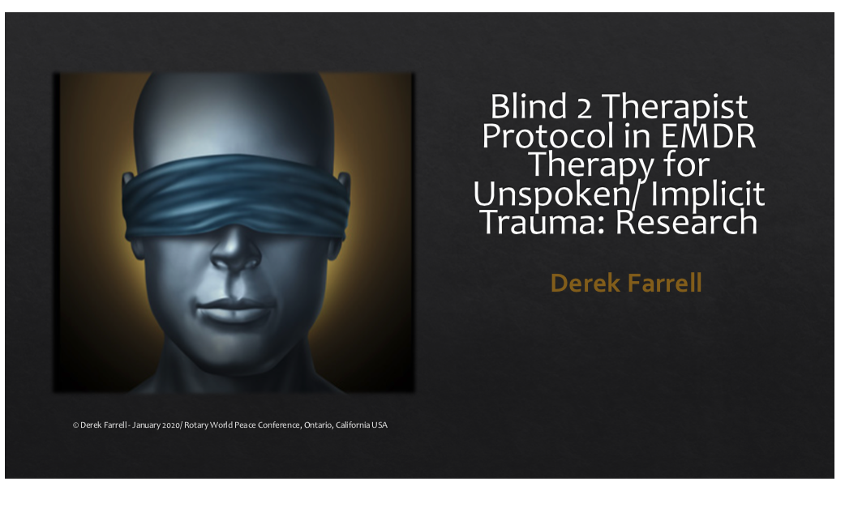

Slide 19
