Slide 1
Healing the hurt
From disaster to recovery

Slide 2
Trauma
A wound
that pierces the armour
WWI - Shell Shock
WWII - Battle Fatigue
Korea - Operational Exhaustion
Vietnam - Not recognised
1980 - Named as PTSD
Post Traumatic Stress Disorder
Notes:
The brain is designed to heal from trauma, just as the body heals from wounds. Basically, PTSD is a problem with memories which get stuck. However, they can be treated with the right psychotherapy. Symptoms have existed forever, began describing in literature in the late 1800s. Pierre Janet after Crimean War and Civil War

Slide 3
Symptoms of PTSD
Hyper-vigilance/hypo-vigilance: irritable, jumpy, anxious, shut down
Intrusive memories: flashbacks, nightmares
Avoidance: people, places, crowds
DSMIII (1980) - based on veterans
DSMIV (1994) - added general population - Disasters
DSM5 (2013) - included children
Notes:
Normally resolved over time. After a major disaster most people will have acute stress symptoms that go away naturally. At 6 months 17% are still affected and at 12 months 6 % continue to have PTSD.

Slide 4
Notes:
This is a synapse in the brain where 2 neurons connect - there are billions which are chemically interactive. A Brain scans the environment 40 times a second - born with a scanner on our shoulders seeking danger and safety.
With fight or flight there is a surge of adrenalin to react. If the danger continues to exist, cortisol increases causing long-term physical and mental damage. Nightmares interrupt our sleep so processing of memories does not occur and the chemical repair work needed by the brain does not happen.

Slide 5
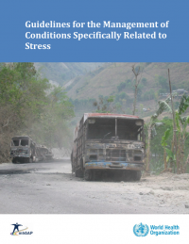
World Health Organisation (2013)
Trauma-focused CBT and EMDR therapy are recommended for children, adolescents and adults with PTSD.
“Like CBT with a trauma focus, EMDR therapy aims to reduce subjective distress and strengthen adaptive cognitions related to the traumatic event. Unlike CBT with a trauma focus, EMDR does not involve:
detailed descriptions of the event
direct challenging of beliefs
extended exposure
homework.” (p.1)
© Derek Farrell - January 2020/ Rotary World Peace Conference, Ontario, California USA
Notes:
The first psychological intervention that showed you could change the symptoms of PTSD and resolve memories was known as EMDR therapy and introduced in 1989. Basically you get a person to recall the memory and use bilateral stimulation to process it. The only other treatment known to work is Trauma-focused CBT which is long-term exposure. Both work by forcing the patient to “confront the memory” and move forward. The hallmark of PTSD is continued avoidance of the memory.

Slide 6
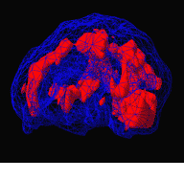
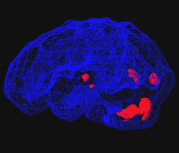
Before and after EMDR brain scans. Left photo shows woman with Post Traumatic Stress Disorder. Right photo shows same patient after four ninety minute EMDR sessions. The red areas indicate over activity in the brain. Photo by Dr. Daniel Amen, reprinted with permission
BEFORE TX
AFTER TX
© Derek Farrell - January 2020/ Rotary World Peace Conference, Ontario, California USA
Notes:
The brain is designed to heal and can do so with the right treatment. Yet only 15 % of people get evidence-based treatment and usually from private practitioners.
So most cases end up in government system where they receive support and counselling but not treatment. And this is where the the links between trauma and mental health costs need to be emphasised. People who have PTSD make up approximately 5 - 6% of the population and are often diagnosed by their symptoms - anxiety, depression, drug and alcohol abuse, self-harm and violence. And treated for these problems - but the memories that tarted and drive the problems continue.
This population of wounded souls make up the majority of homelessness, prison populations, psychiatric wards and long-term mental illness.
And it begins in childhood….

Slide 7
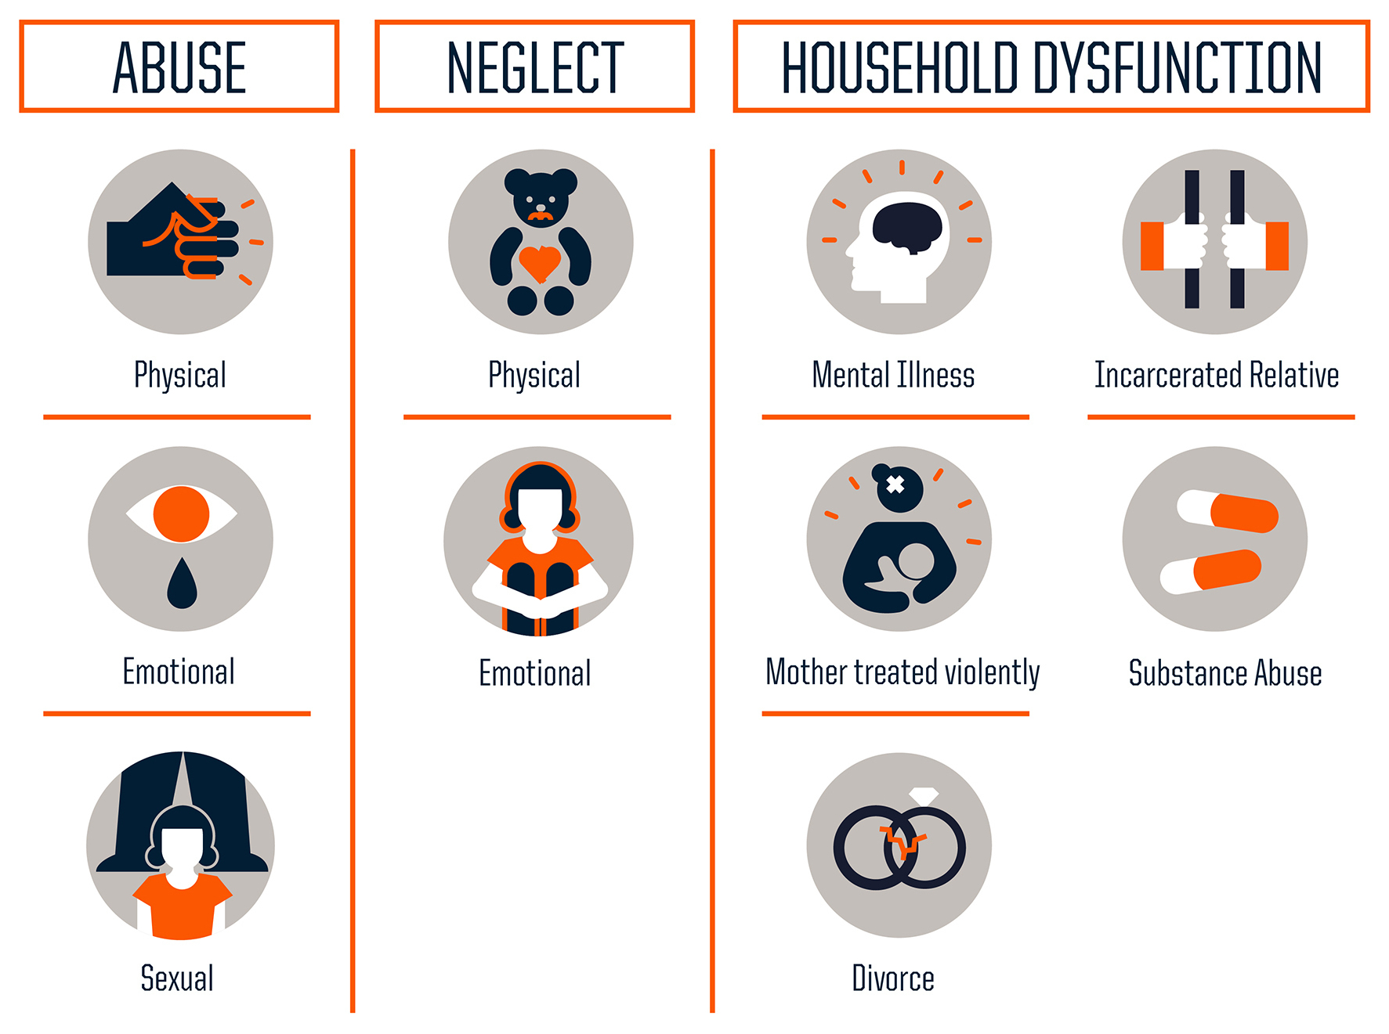
The Adverse Childhood Experiences Study (ACES)
Filetti, 1997
Notes:
The Adverse Childhood Experiences Study was done in 1997 and has been replicated around the world. Internationally have added bullying, war, terrorism, and long-term disruption such as refugee camps.
People with 4 or more of these events are four times more likely to have physical and mental health problems such as heart disease or depression. They are 12 times more likely to be suicidal.
And when you separate the substance abuse users from non-users the outcomes are just the same. Early childhood trauma interferes with brain development, the ability to learn and socialise with others.

Slide 8
Notes:
The most common ACES is family separation and violence. Not only do these children witness or experience trauma which makes them fell they are helpless (which is true because they are small children and unable to save themselves) , they also are more vulnerable to bullying, abuse by others, being treated poorly at school and unable to find safety.
The literature on the extent of trauma in populations continues to grow, increasing our understanding of the issues involved.

Slide 9
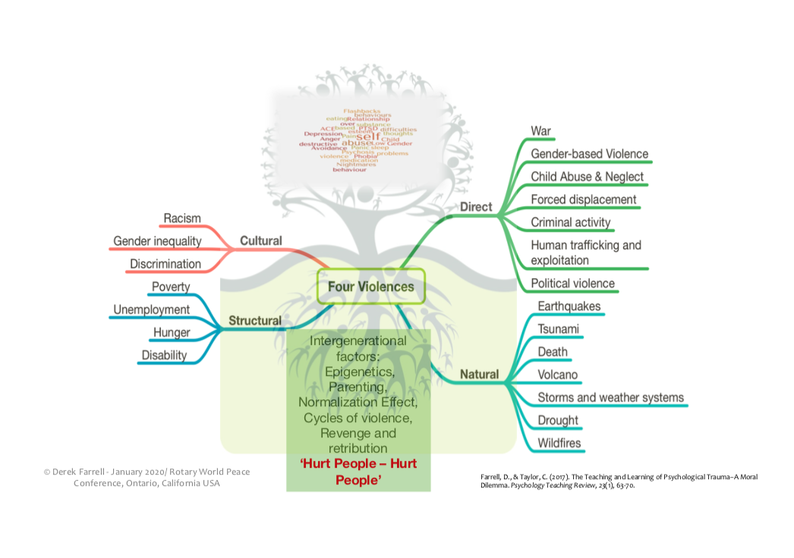
Notes:
By changing our thinking from “What is wrong with you”?
To “What happened to you”?
We are able to change how the individual sees themselves and recover from the memories that cause the PTSD.

Slide 10
Notes:
Keep in mind that while the numbers are large, they represent a small percentage of the population. However, this small percentage accounts for most of the money spent on treating mental illness so the treatment of trauma would significantly change the landscape of mental health issues.

Slide 11
Resources to meet the demand
TIER 3 Specialised Trauma Therapists
TIER 2 GROUP CARE BY PARAPROFESSIONALS in progress
TIER 1 Psychological First Aid and self care
Notes:
As I said earlier, most people heal from traumatic experiences with time and social support. This is being done now in communities, there are lots of counselling services, religious organisations and support groups that help people as they heal.
So the issue is how to intervene and help those who are “stuck” so they can heal now and not spend years experiencing mental illness and social disruption? We have trauma therapists in many countries, some less than others (Iraq has only 12 psychologists).
So the need is to train paraprofessionals and other services basic trauma treatment skills - Red Cross workers, counsellors, nurses, doctors, etc how to do early interventions to prevent PTSD as first responders. If we can resolve the memory in the first three months before it consolidates we can prevent PTSD. And if there is PTSD, the sooner we treat it the less effect it has on the clients life.

Slide 12
What has rotary done so far?
RC Melbourne: Foundation House- Refugees Tier 3
RC Melbourne : Royal Children’s Hospital Melbourne Tier 3
RAG for Family Safety: Victims of Institutional Abuse : Therapist up-skilling Tier 3
RAG for Family Safety: Best Practice for major Disasters Tier 3
Notes:
We have trained professional therapists working with refugees and children in the Child and Adolescent Sexual Assault Unit. Experienced people who know how to care for people but now know how to treat the memories that cause the trauma.
In the process of developing programs for the recent bushfires in Australia, early intervention on-line therapy with COVID19 then move towards teaching the skills to affected community workers.

Slide 13
COMMUNITY-BASED SOLUTION- GROUP CARE
TREAT GROUPS AS WELL AS INDIVIDUALS
”Equip and empower frontline non-therapist personnel with intermediate yet appropriate skills to make best use of the few mental health professionals available” (GIST-T 2019)
Notes:
At the moment we are working on a program to address the recent bushfires we had in Australia in January 2020. We had begun this project with a plan to develop community group interventions. However, COVID19 has disrupted these plans while, at the same time, opened new opportunities.
We now have access internationally to on-line mental health care supported by many governments. On-line therapy has proved as effective as in person meetings and ours cope to reach remote populations and first responders immediately after an event has expanded exponentially.
In addition, the capacity to do on-line training of par-professionals in many languages has also become a reality. And, methods of group on-line therapy have also been trialled and proved successful.

Slide 14
Who are these frontline personnel?
HEALTH CARE WORKERS – Nurses, Doctors, Community Health Workers
SOCIAL CARE WORKERS – Teachers, traditional spiritual leaders, Red Cross
Volunteers, Scout Leaders
EMERGENCY SERVICES – including military
OTHER NGOs - service club members, including Rotarians

Slide 15
HOW CAN WE DO IT?
STEP ONE - TRAIN TRAINERS from relevant communities
STEP TWO - TRAINERS train frontline personnel (research component)
STEP THREE - FRONTLINES deliver simplified Group Care
(supervised and supported, self-care, research)
Notes:
For development in ares of long-term need such s high levels of family violence, including perpetrators we can train professionals to be trainers and work as consultants to frontline personnel.
For disasters we can immediately work with first responders. Then develop connections in the community to begin training paraprofessionals to work with groups.

Slide 17
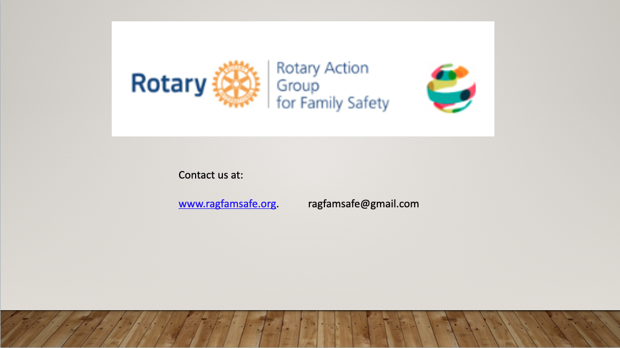

Slide 18
QUESTIONS, PLEASE!

